Slide 1
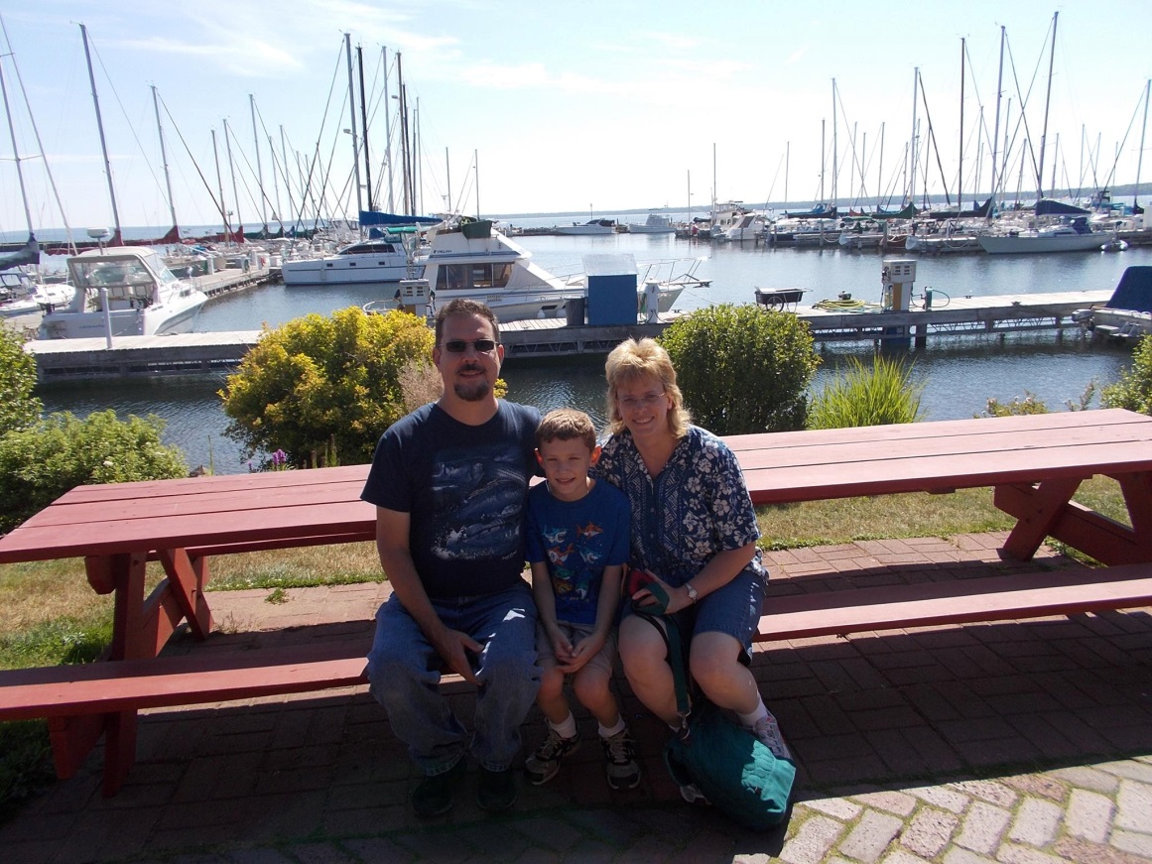

Slide 2
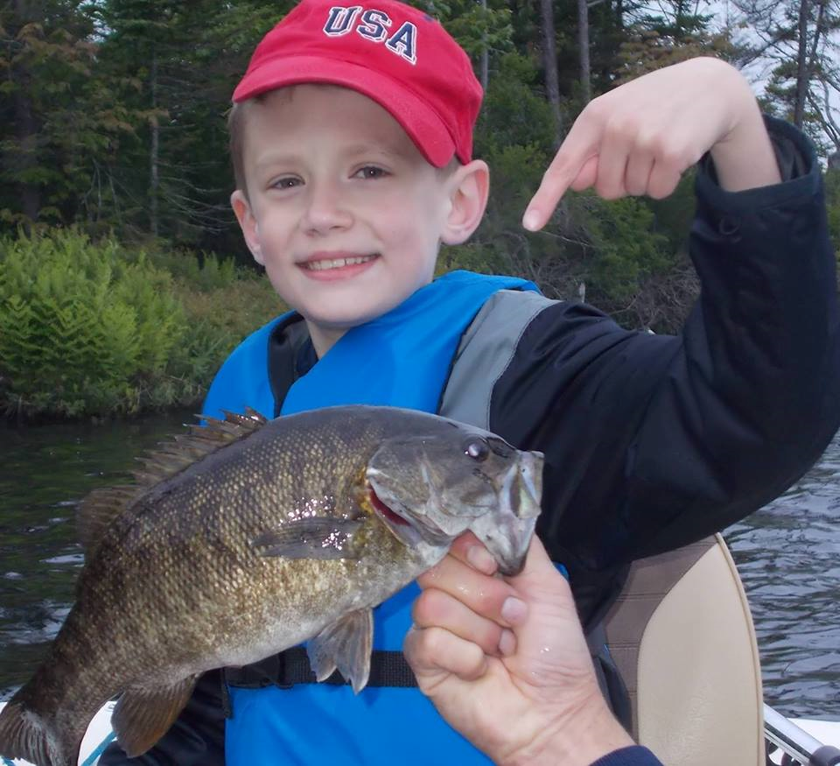

Slide 3
Library Expectations
Be Respectful
Be Safe
Be “On Task”
Be Responsible
Enter, leave and work quietly because others are also trying to work here.

Slide 4
Types of Voices
0 – Silent
1 – Whispering Voices
2 – Buddy Voices (Quiet, talking voices)
3 – Playground Voices
4 – Emergency Voices

Slide 5
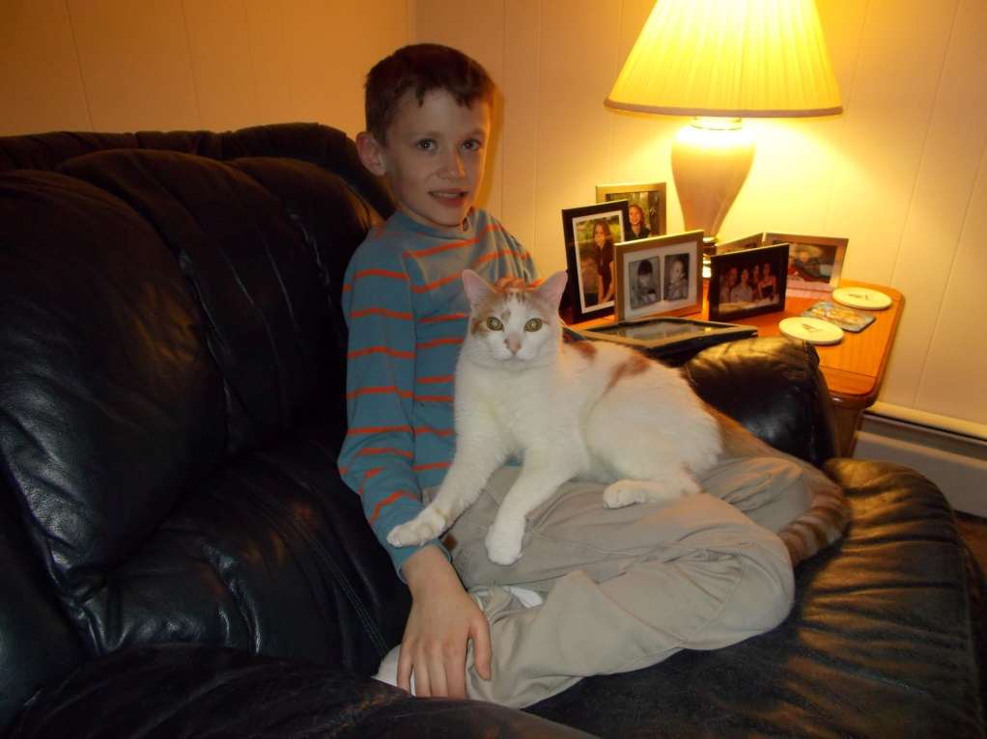

Slide 6
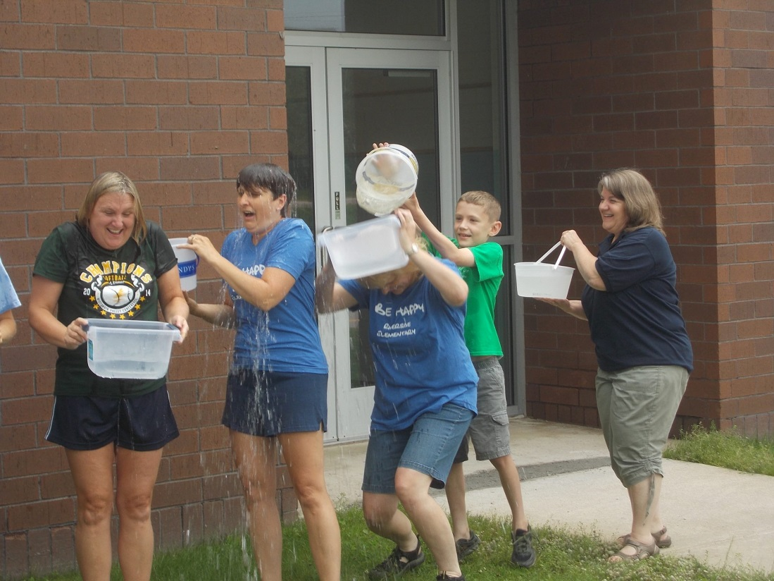

Slide 7
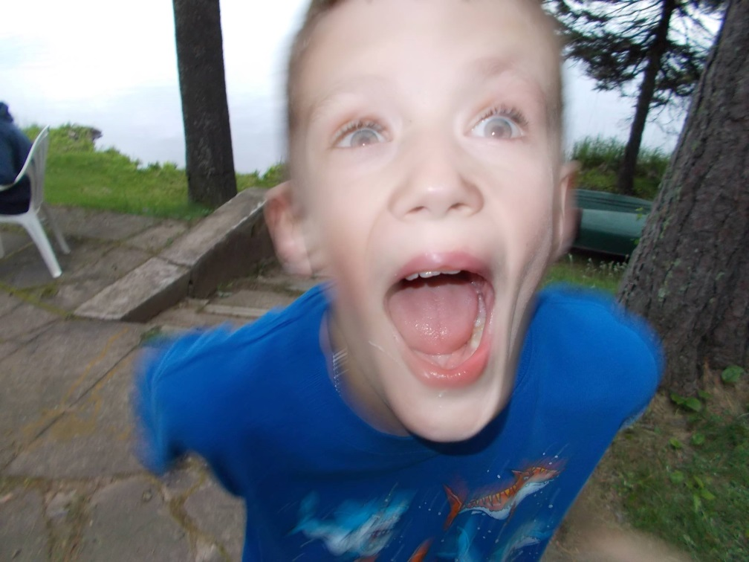
What happens when you eat 10 toasted marshmallows?

Slide 8
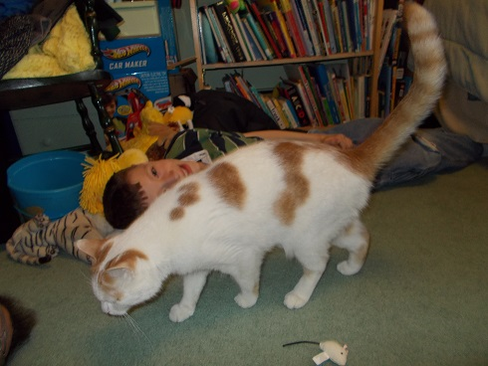
Meet Marcus
http://safeshare.tv/w/WemvRaCBem

Slide 9

Computer Parts
C/T 4.1.b
Communicate about basic technology components with appropriate terminology.

Slide 10
keyboard

Slide 11
mouse

Slide 12
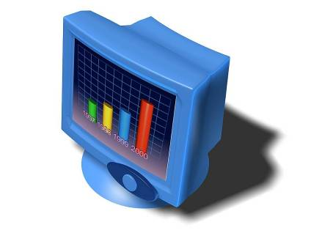
monitor

Slide 13
CPU

Slide 14
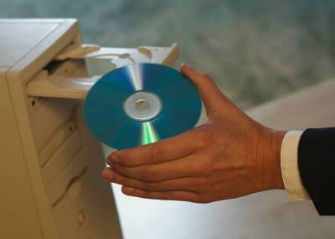
CD-Rom Drive

Slide 15
speakers

Slide 16
CDs

Slide 17

Pen drive

Slide 18
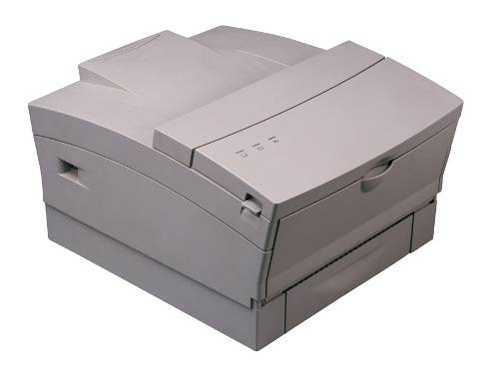
printer

Slide 19
digital camera

Slide 20
headphones

Slide 21
How should we treat the computer?

Slide 22
Who remembers….
How to log into the computer?

