Slide 1
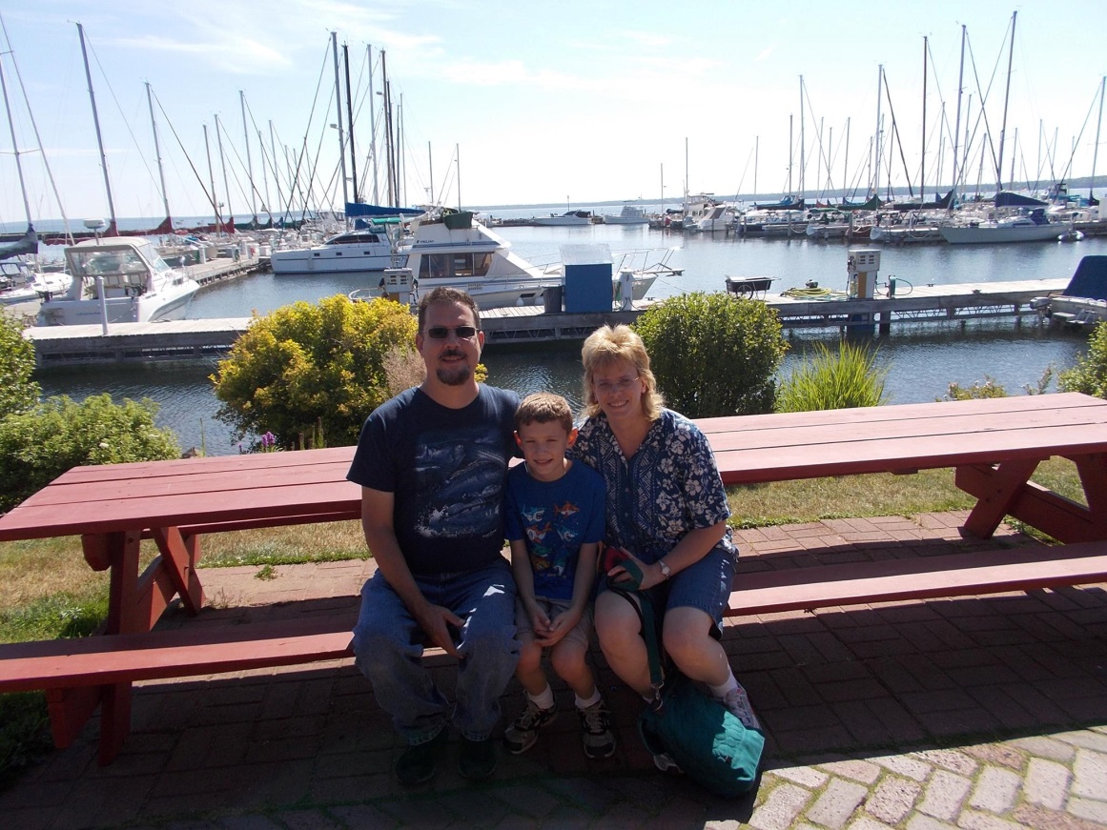

Slide 2
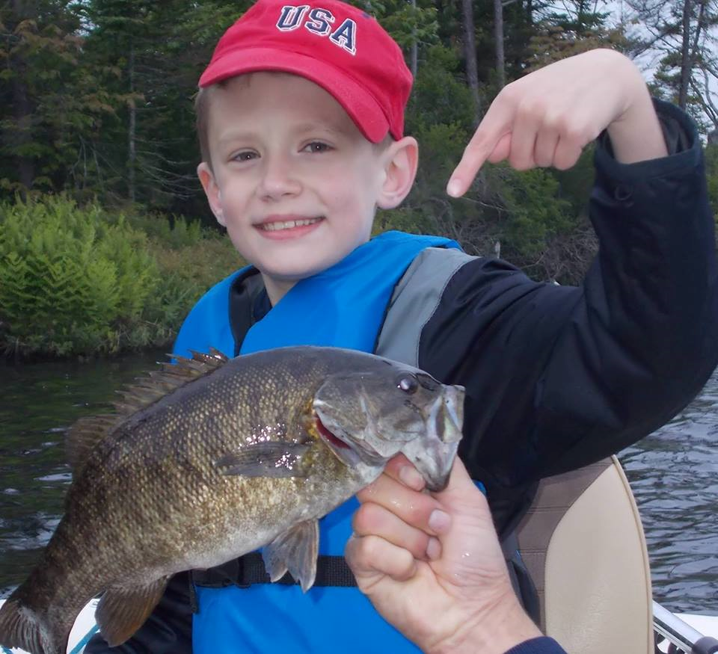

Slide 3
Library Expectations
Be Respectful
Be Safe
Be “On Task”
Be Responsible
Enter, leave and work quietly because others are also trying to work here.

Slide 4
Types of Voices
0 – Silent
1 – Whispering Voices
2 – Buddy Voices (Quiet, talking voices)
3 – Playground Voices
4 – Emergency Voices

Slide 5
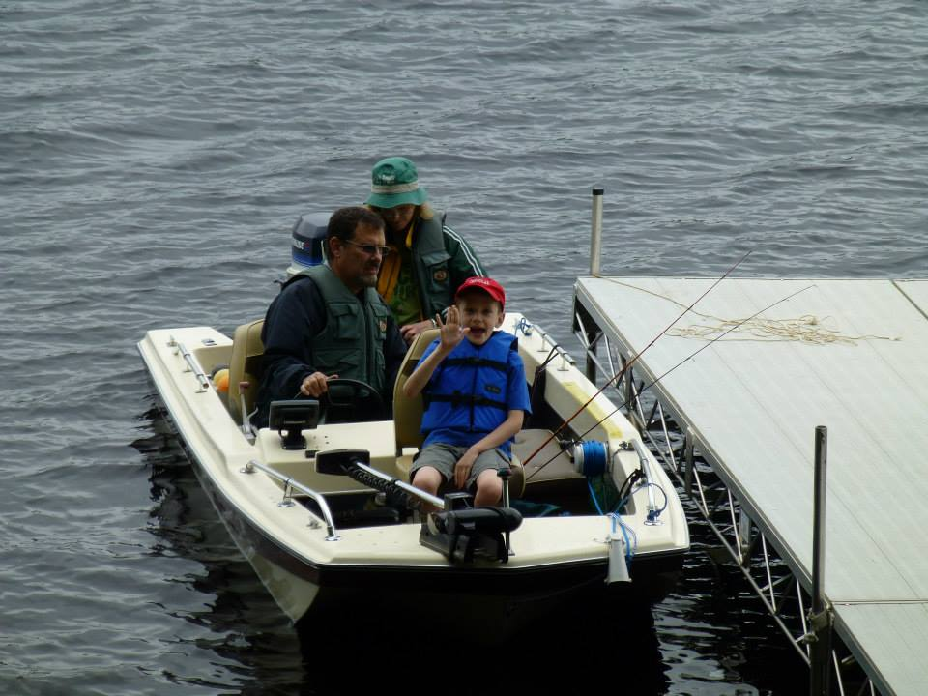

Slide 6
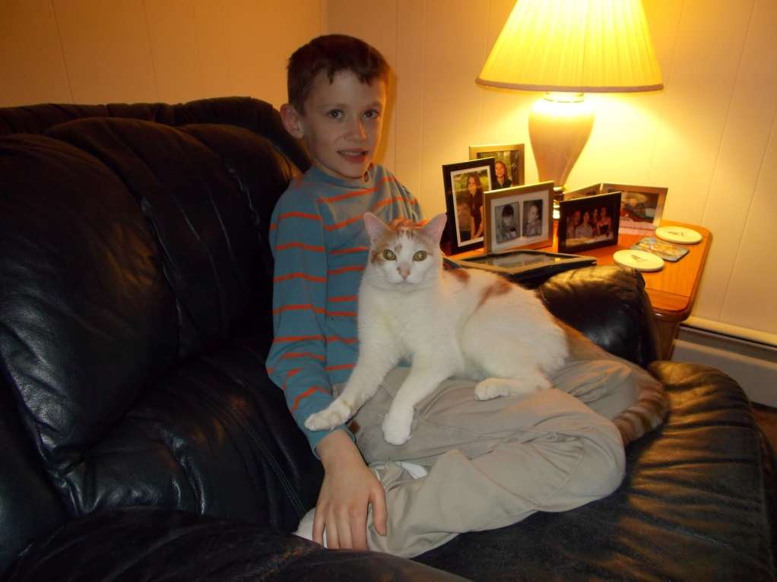

Slide 7
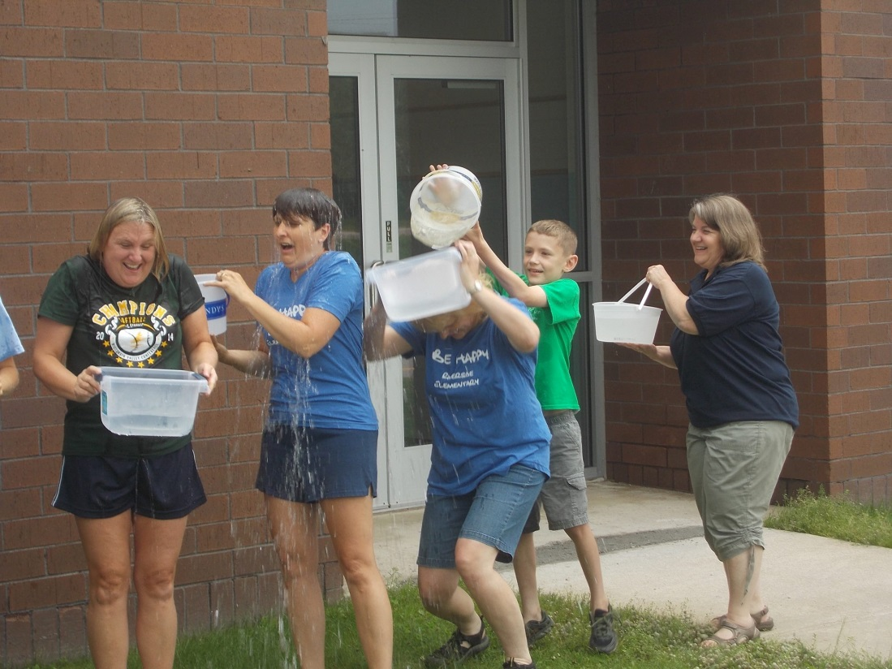

Slide 8
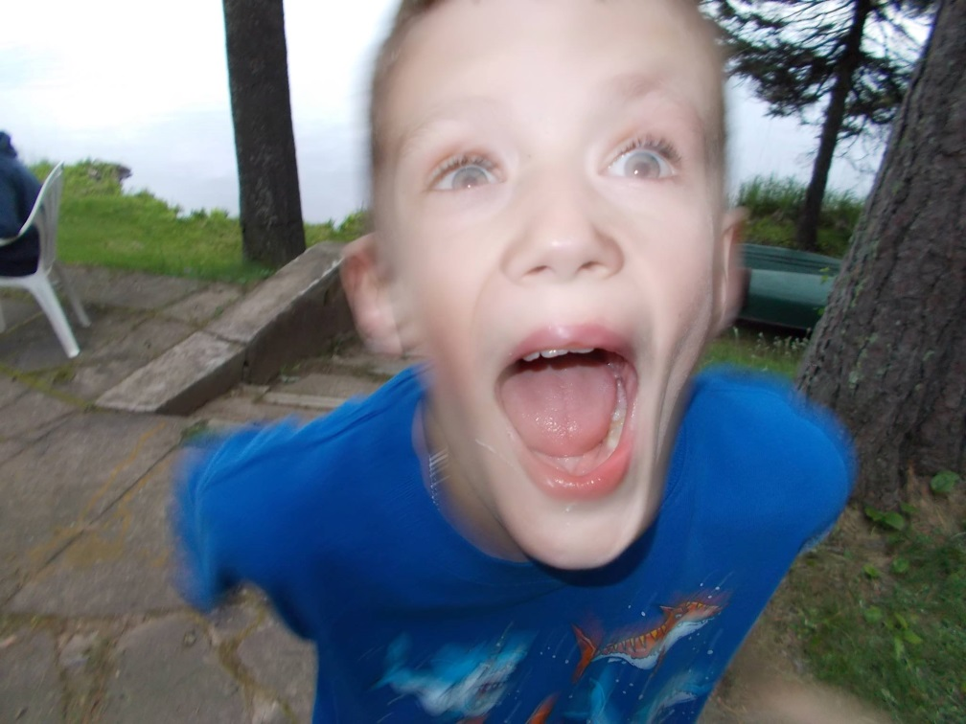
What happens when you eat 10 toasted marshmallows?

Slide 9
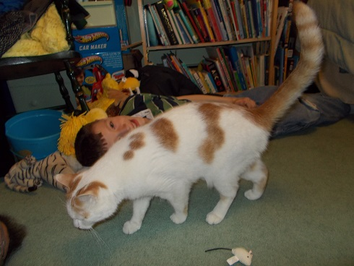
Meet Marcus
http://safeshare.tv/w/WemvRaCBem

Slide 10

Computer Parts
C/T 4.1.b
Communicate about basic technology components with appropriate terminology.

Slide 11
keyboard

Slide 12
mouse

Slide 13
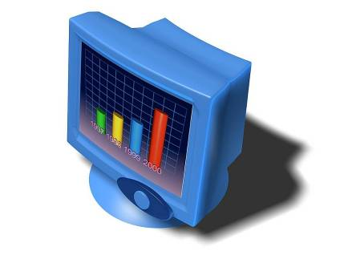
monitor

Slide 14
CPU

Slide 15
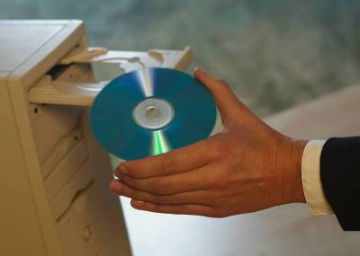
CD-Rom Drive

Slide 16
speakers

Slide 17
CDs

Slide 18

Pen drive

Slide 19
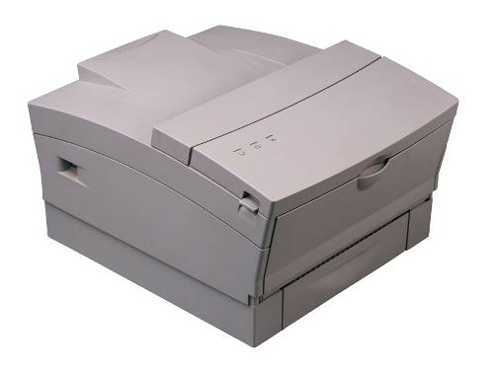
printer

Slide 20
digital camera

Slide 21
headphones

Slide 22
How should we treat the computer?

